Slide 1

WORK STUDY TRACKER
Keiser University Student: Gerson Rodriguez and José Guadron

Slide 2
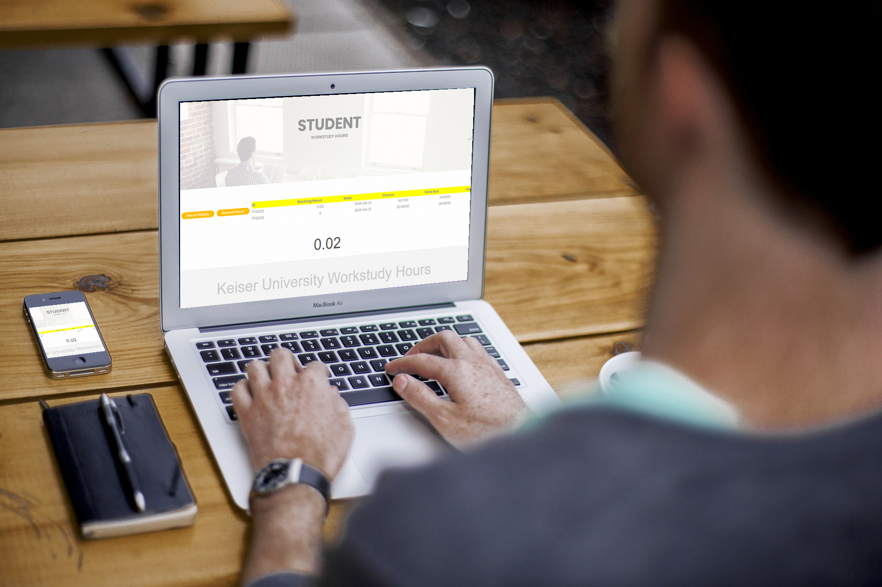
ACCESSIBILITY
Access wherever you are.
Work Study Tracker allows you to connect everywhere with internet connection.

Slide 3

UPDATED COMPONENTS TO HAVE THE BEST SECURITY
-Md5 Encryption Protection.
-Double check Pin Security.
SECURITY
Your protection is our concern.

Slide 4



Friendly
INTERFACE

Slide 5
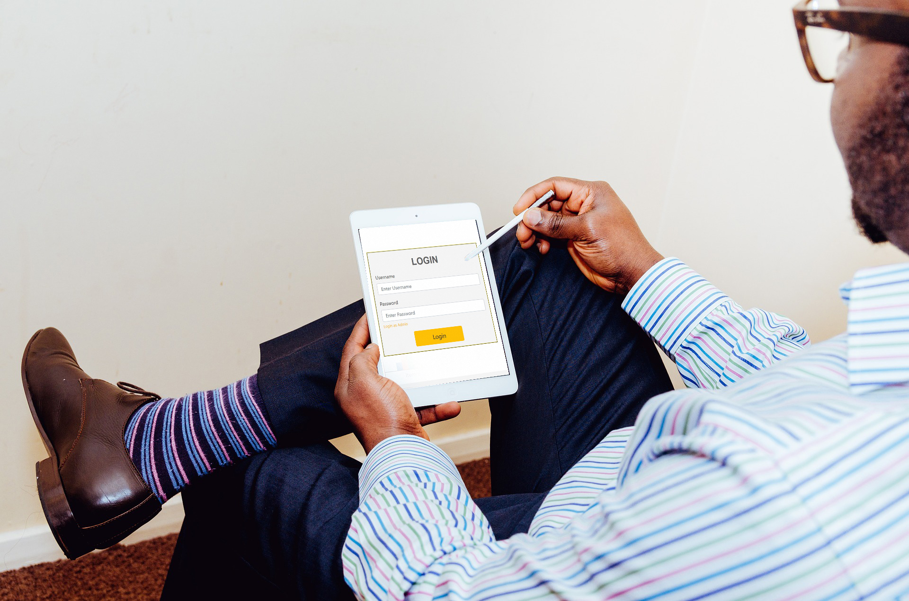
Organize
YOUR SELF
STOP wasting time filling out
your hours record papper!

Slide 6

Multiple Users
Log in System
-Multiple users can log at the same time
-Ideal for Business

Slide 7

SAY NO TO PAPER
SAY YES TO AUTOMATIZATION
On the next corner

Slide 8
INSERT VIDEO HERE

